Slide 1
Just One More Ministry Tracking Software
By: Adam Honts, Harminder Braich, Shawn Strong

Slide 2
Main Problem
Just One More Ministry is a food donation service that is using a complex system called QuickBooks to track all of the organizations that donate/take food from their system. A large portion of the current system is currently unused and will likely remain unused in the future.

Slide 3
Goal
Simplify the tracking system for Just One More Ministry so that all of their required functionality is present and extra unnecessary features are removed

Slide 4
System Breakdown
Organizations
Add new organizations
Edit and delete existing organizations
Donations
Enter donations
Edit and delete previous donations
Reports
Generate reports based on a weekly, monthly or yearly format

Slide 5
Added Features
For logged in users, the system enables some helpful tools to streamline the process
Collaborative Filtering
For each organization, the input donation form rearranges the food categories in descending order based on the total weights entered
Smart Widget
After a month of observing the donation process, a suggestion widget will attempt to predict the order of the organizations that come on a daily basis
Voice Commands
Ability to navigate through the various sections of the system and input donations using the Smart Widget

Slide 6
Evaluation
Manual Data Entry (user is not logged in)
Time
Manual and Smart Widget Data Entry (user is logged in)
Time
Smart Widget (user is logged in)
Time
Voice Commands
Time
# of Commands
SUS

Slide 7
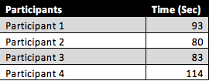

Manual Data Entry Results

Slide 8


Smart Widget (Two New Organizations)

Slide 9
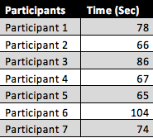

Smart Widget (No New Organizations)

Slide 10

Smart Widget (No New Orgs) vs No Widget
Student’s t Test
Null Hypothesis: Widget Time = No Widget Time
Alternative Hypothesis: Widget Time < No Widget Time

Slide 11
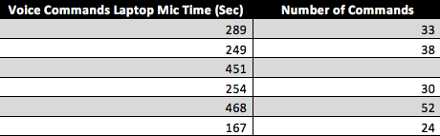
Voice Command Data Entry Laptop Mic
Optimal Number of Commands = 22

Slide 12
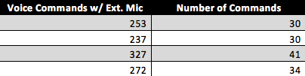
Voice Commands Data Entry External Mic
Optimal Number of Commands = 22

Slide 13
External Mic Time vs Laptop Mic Time
Null Hypothesis: External Mic Time = Laptop Mic Time
Alternative Hypothesis: External Mic Time < Laptop Mic Time
t statistic = 6.614
P value = .000084

Slide 14
External Mic Commands vs Laptop Mic Commands
Null Hypothesis: External Mic Commands= Laptop Mic Commands
Alternative Hypothesis: External Mic Commands> Laptop Mic Commands
t statistic = .8555
P value = .21

Slide 15
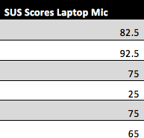

SUS For Voice Command Data Entry Laptop Mic

Slide 16
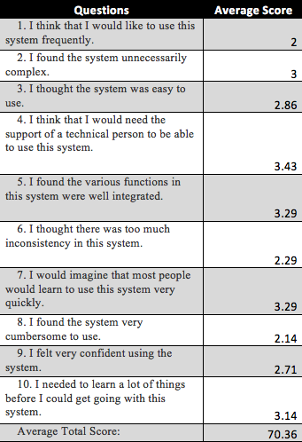
SUS Questions Average w/ Laptop Mic

Slide 17
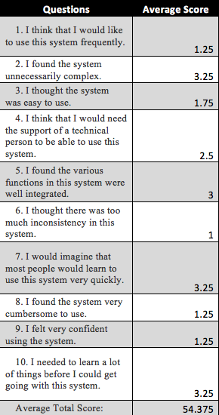
SUS Questions Average w/ External Mic

Slide 18
Both SUS Scores

Slide 19
Discussion
Widget increases efficiency, if the widget can predict organizations
Laptop Mic takes more time to enter data than External Mic
SUS scores show that people would rather not use voice commands
SUS scores show that people find the voice commands easy to use

